Slide 1
Making Sense
of the
Changing Landscape in Healthcare

Slide 2
US Healthcare Costs in Context: vs. the GDP of Large Countries
GDP (nominal) in 2015 Rank
USA $15.65 trillion #1
CHINA $8.25 trillion #2
JAPAN $5.98 trillion #3
GERMANY $3.37 trillion #4
US Healthcare spend: $2.74 trillion
FRANCE $2.58 trillion #5
UK $2.43 trillion #6
BRAZIL $2.42 trillion #7

Slide 3
US Healthcare Economics
In 1980, U.S. health care costs were about as much of GDP as in other developed countries
  But inflation has been brutal
  If food price inflation since 1945 matched that of health care
  We would be paying what for a dozen eggs today?
  $55 !
Why? Many contributors…
  Technology ~10%
  Drug and device development costs ~15%
  Waste ~25%
    Unnecessary services
    Inefficiently delivered services
    Excessive administrative costs
  More and more procedures ~20%
  End-of-life care ~ 15%
  Cost shifting ~10%
  (better) Physician pay ~5%

Slide 4
Health Care Spending as a Percentage of GDP
Percent
GDP refers to gross domestic product. Data in legend are for 2014.
Source: OECD Health Data 2016. Data are for current spending only, and exclude spending on capital formation of health care providers.

Slide 5
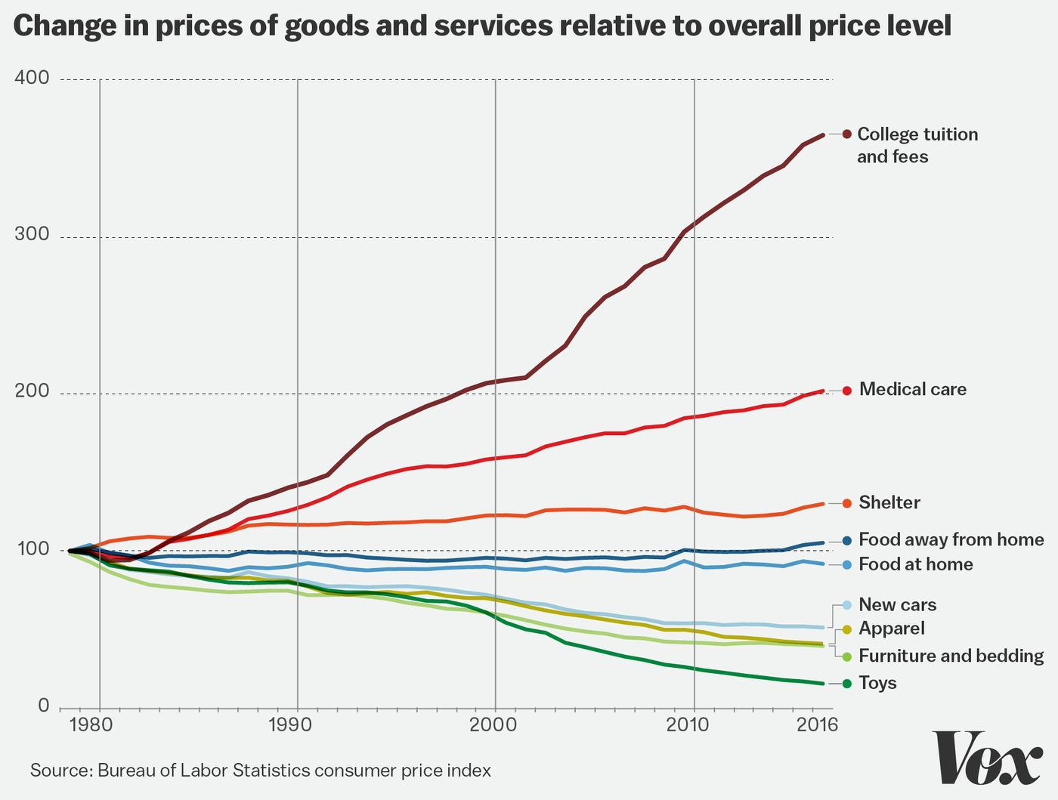
US Healthcare Economics

Slide 6
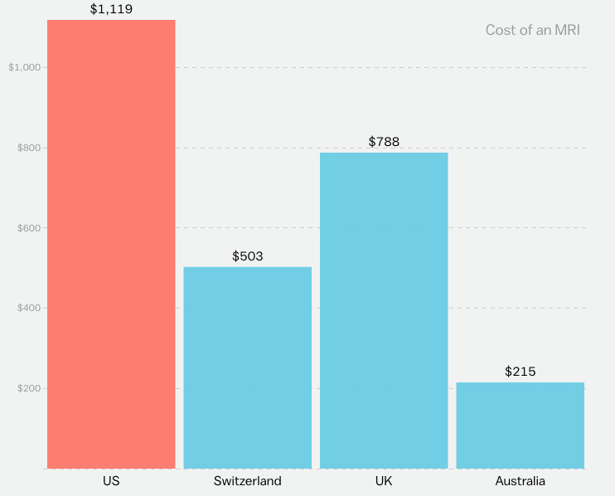
Cost of an MRI

Slide 7
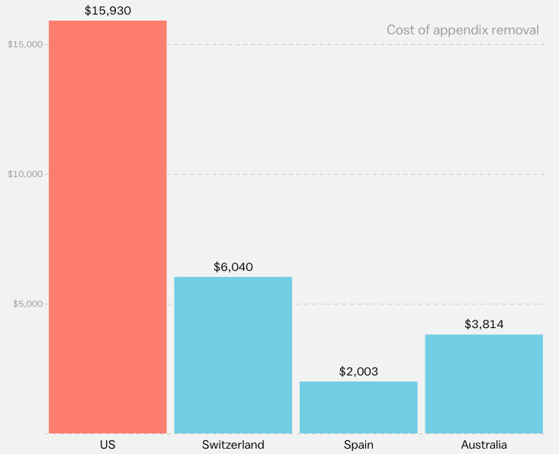
Cost of an Appendectomy

Slide 8
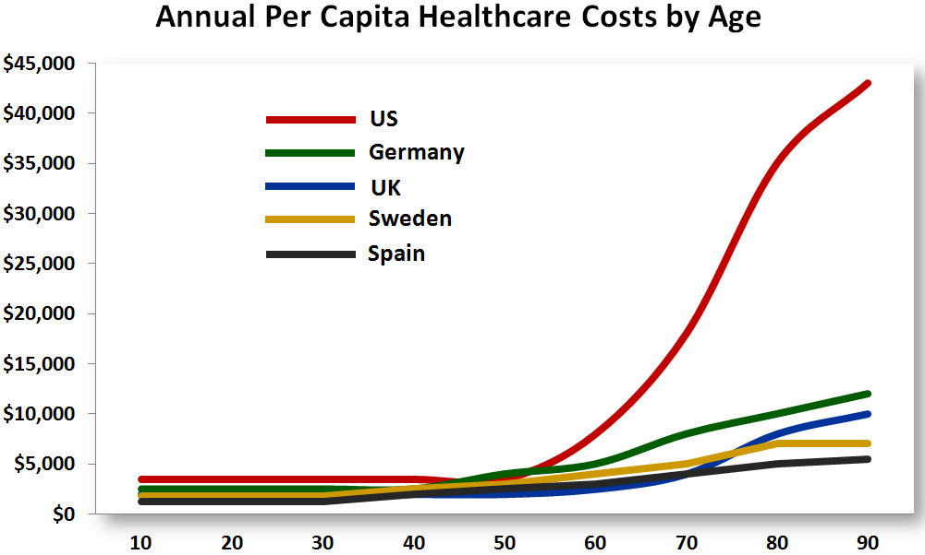
End-of-Life Care

Slide 9
How can the best medical care in the world cost twice as much as the best medical care in the world?*
Spending per Medicare beneficiary with severe chronic disease
(Last 2 years of life)
Cedars-Sinai (LA) $76,934
UCLA Medical Center $72,793
New York-Presbyterian $69,962
Johns Hopkins $60,653
UCSF Medical Center $56,859
Univ. of Washington $50,716
Mass. General $47,880
Barnes-Jewish $44,463
Duke University Hosp. $37,765
Mayo Clinic (St. Mary's) $37,271
Cleveland Clinic $35,455
*Uwe Reinhardt

Slide 10
Who is costing the most?

Slide 11
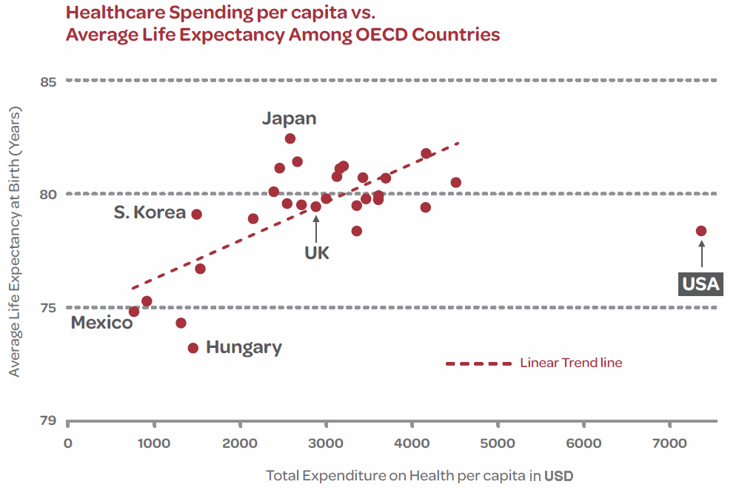
Do We Get Better Outcomes?

Slide 12
Affordable Care Act Effects
aka “Obamacare”

Slide 13
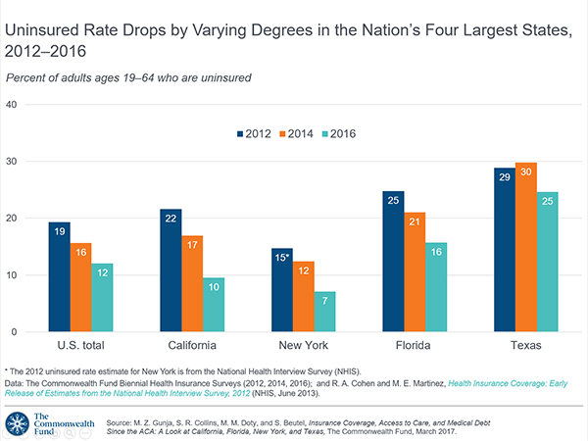
ACA Effects

Slide 14
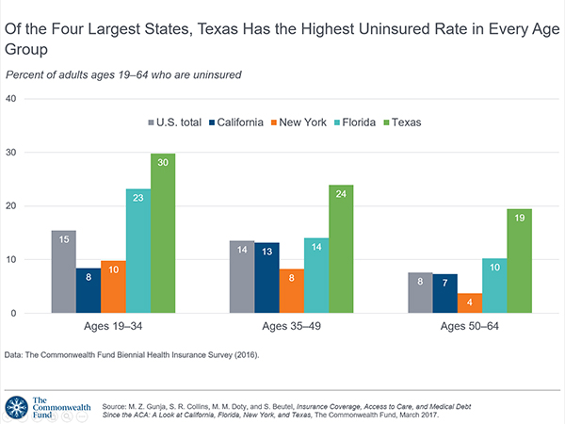
ACA Effects

Slide 15
But Coverage Is Not The Same As Access

Slide 16
Percentage of physicians who say they currently do not see Medicare patients:
Top 5
Nevada 22.5%
Virginia 22.2%
New Jersey 18.9%
Arkansas 18.5%
Texas 18.4% North Texas: 26.4%
Bottom 5
South Dakota 2.9%
Maine 5.0%
North Dakota 5.6%
Montana 5.7%
Iowa 8.0%
California (14.6%) and New York (15.2%)

Slide 17
Percentage of physicians who say they currently do not see Medicaid patients:
Top 5
New Jersey 32.2%
Texas 29.9% North Texas: 36.8%
Florida 29.1%
Georgia 23.7%
California 22.1%
Bottom 5
Idaho 1.5%
Vermont 2.1%
South Dakota 2.9%
Montana 2.9%
Wyoming 3.2%
New York (16.5%)

Slide 18
So What Is Next?

Slide 19
What does the future look like?
TODAY FUTURE
Fragmented care Coordinated across continuum
Organized around providers Organized around patients
Fee for volume Fee for value
Facilities-focused Information-focused
Physician accountability Care team accountability
Paper Electronic
Episodic and Hospital-based Longitudinal across continuum
Inconsistent, variable practice Evidence-based care
Data silos Information exchange

Slide 20
Payment Reform and Population Health Transition
Providers/Payors must bridge this gap
Fee-For-Service
Population Health Management
Reduced ER Visits
Capitated Risk
Reduce Re-admissions
Gainshare Contracting
Reduced Revenue
Revenue Control
Reduce Admissions
Care Coordination/Pt. Engagement
Reduced Specialty Visits
PCMH/PCP Engagement
Reduced Procedures/1000
“Loss Valley”
EHR/Central Data Repository
The Question Is: At what Pace?

Slide 21
The Institutional Problem
Like most AMCs:
  Deeply tertiary and quaternary faculty
    1750 faculty = ~1100 Clinical FTEs
    79 faculty PCPs = ~45 Clinical FTEs
  ~2000 patients per PCP FTE = 90,000 population
    Insufficient to maintain tertiary and quaternary programs
      e.g. NCI Cancer Center or Transplant programs
    Insufficient population to maintain subspecialty Fellowships
    Insufficient to population support clinical and translational research
  Facing exclusion from side-by-side and narrow networks
  MACRA/MIPS payment threat
  Payment Reform towards fee-for-value
  Perception of being the ‘highest cost’ providers
    Lack of useful comparator data
    Unit costs v. total costs of care

Slide 22
Employers Transitioning…
Payer Attribution ACO: Member attributed to PCP from prior year’s visits
PCP Tiered Model: Member attributed to PCP as a result of PCP benefit differential (copay reduction)
Facility Tiered Model: Narrow network with benefit differential at the point of care
Side-by-Side Product Model: Narrow network with premium contribution decrement at the point of enrollment
Full Replacement Product Model: Full replacement narrow network with premium contribution decrement, benefit differential and gatekeeper model
D I SRUPT ION
Full Replacement Model
Side-by-Side
Product Model
Facility Tiered Model
PCP Tiered Mode
Payer Attribution ACO Model
Total Cost of Care Savings
Payer Attribution
PCP Tiered Model
Facility Tiered Model
Side-by-Side Product
Full Replacement Product
Notes:
Healthcare Evolution

Slide 23
What Does Excellence Look Like?
Apply analytics to identify and target high-need, high-cost patients (5% of patients account for 50% of cost)
  Where does Ob-Gyn fit into this?
Adopt care management programs for complex or high-risk patients
Address unnecessary variation and cost of ED, acute and post-acute care
Integrate behavioral, and community-based services
Provide tools to providers and consumers to help them manage their conditions and better coordinate care
  Telemedicine, wearable devices, electronic tools/communication, genomics, proteomics and artificial intelligence are just beginning their impact

Slide 24
What Will Success Look Like?
Do you provide a differentiated patient experience?
  Delivery of care only in the office (after an average 38 minute wait) or by alternative sites and telemedicine?
  Uber-type care would be on your watch with advice when you wanted it, not just 8:00 to 5:00 M-F
Are you measuring and demonstrating outcomes?
True outcomes? The disruptor will prove to the public that they are better and faster for access!
Can you demonstrate that your care is more cost effective while providing same or better outcomes?
Do you even know what it costs you to provide an episode of care? In ambulatory plus inpatient?
Do you assess accuracy of diagnosis? Reliability of treatment?
Are you a team of providers? Is your incentive program based on group performance or individual?

Slide 25
Solutions?
Dive into Fee-for-Value
  Resources and Tools to manage populations
  Reduce total cost-of-care
    Requires data and dissemination
    Must know internal costs to provide care
Alternative Revenue Streams
  Medicare Shared Savings Program
  Medicare Advantage
  Gain-share commercial contracts
  Risk-based contracts
    MSSP Track 1+, Track 2, track3, NextGen
  Intergovernmental Transfer programs
    NAIP
    1115 Waiver
    1332 Waiver

Slide 26
Population Health Services
(Which of these are you doing?)
Scope of Services:
  Data Analytics/Actuarial Analysis and Workflow Platform
    Risk stratification
    Predictive modeling
  Practice-Centric Services
    Scheduling/Access/Referral Management/Care Navigation
    EMR and IT Services for Physician Groups
  Total Cost-of-Care Performance Dashboard
  Care Coordination Services
    Care Gap Identification/Closure
    Care Transitions Management
    Chronic Disease Management/Care Models
  Care Administration Services
    Utilization Management/Review
    Bundles Administration
  Quality Improvement
    Dashboard and specific goals
  Patient Experience and Engagement
  Post-Acute Care Network with Scorecard

Slide 27
The Challenge to Obstetrics and Gynecology
We know more areas of Medical Practice than any other specialty:
  We run:
    An ER
    An OR
    A Med/Surg Unit
    And ICU
    An imaging unit
    A laboratory (at least at point-of-care)
  We are:
    Primary care
    Specialty care
    Sub-specialty care
    Surgeons and proceduralists
    Heavy influencers of care selection
    by families

Slide 28
So why are we not leading these fundamental changes?

Slide 29

Questions?

Slide 30
Affordable Care Act (“Obamacare”)
Popular Parts of the ACA:
  Prohibiting insurance companies from denying coverage for pre-existing conditions and cannot charge a higher rate (why some people’s plan costs went up)
  Requiring certain preventative services to be provided without additional out-of-pocket charges
  Allowing young people to be included on parents’ insurance policies until age 26
These are all expensive (especially pre-existing conditions)
  Paid for by (unpopular) additional taxes including the tax penalty on people who remain uninsured (a provision designed to generate revenue and defray costs), additional taxes on those making more than $200,000/year (or $250,000 as a couple) and a “Cadillac” tax on health plans that significantly limited out-of-pocket expenses

Slide 31
Affordable Care Act (“Obamacare”)
More than 30 million Americans have health insurance under the provisions of the Affordable Care Act. The national rate of uninsured working-age adults dropped from 19.6% in 2010 to 12.0% in 2016.
  Coverage through expanded Medicaid eligibility
  Tax credits to help pay for premiums
  State and Federal outreach efforts
  Market regulations
The Law and Supreme Court ruling gives states flexibility in implementing provisions so States fall into two distinct categories:
    First group, e.g. California and New York, operate their own health insurance marketplaces and have expanded eligibility for Medicaid to adults with incomes at or below 138 percent of the federal poverty level
      $16,394 for an individual or $33,534 for a family of four
    Second Group, e.g. Florida and Texas, are using the federal marketplace to enroll residents in health plans and have declined to expand Medicaid eligibility

Slide 32
Deciphering the Alphabet Soup
Patient Centered Medical Homes (PCMH):
  Focus on care improvement from primary care services
  Institute a series of processes that have been shown to permit better outcomes
  for example, activities that help patients with compliance/understanding of medical care or to do self-management
Clinical Integration (CI):
  Focuses on care improvement for physician practices across all specialties
Accountable Care Organization or Network (ACO or ACN):
  Focus on improvement in care for populations of people across the continuum of care (preventive, outpatient, inpatient, past-acute, etc.)
  Providers are willing to bear some or all risk for the health care costs and needs of a defined population of (commonly Medicare) recipients
  Also refers to the efforts of providers to work with payers to develop capitation arrangements to pay for focused populations with defined sets of health needs
Behavioral Health Organization (BHO):
  Focuses on primary care providers, mental health providers, substance use providers, and other specialty providers to link together to care for patients with significant behavioral health and substance use problems
Affordable Care Act (ACA): aka Obamacare
American Health Care Act (AHCA): House Republican alternative

Slide 33
Deciphering the Alphabet Soup (Health Plans)
Preferred Provider Organizations (PPOs)
  A moderate amount of freedom to choose your health care providers -- more than an HMO; you do not have to get a referral from a primary care doctor to see a specialist.
  Higher out-of-pocket costs and more paperwork if you see out-of-network doctors vs. in-network providers
  You pay a premium, a deductible, a co-pay and higher cost for out-of-network care
Health Maintenance Organizations (HMOs)
  You pay a premium, a deductible and a co-pay
  The least freedom to choose your health care providers
  The least amount of paperwork compared to other plans
  A primary care doctor to manage your care and refer you to specialists when you need one so the care is covered by the health plan; most HMOs will require a referral before you can see a specialist.
Exclusive Provider organizations (EPOs)
  more freedom to choose a provider than an HMO; you do not have to get a referral from a primary care doctor to see a specialist.
  No coverage for out-of-network providers; if you see a provider that is not in your plan’s network – other than in an emergency – you will have to pay the full cost yourself.
  You pay a Lower premium, a deductible and co-pay

Slide 34
Deciphering the Alphabet Soup
Point-of-Service Plans (POS)
  More freedom to choose your health care providers than you would in an HMO
  A moderate amount of paperwork if you see out-of-network providers
  A primary care doctor who coordinates your care and who refers you to specialists
  You pay a premium, a deductible and co-insurance (a percentage of charges)
  If you go out-of-network, you have to pay your medical bill. Then you submit a claim to your POS plan to pay you back
High-Deductible Health Plans (HDHPs)
  Can have any one of these types of health plans: HMO, PPO, EPO, or POS
  You pay a premium, a high deductible (between $1250 and $6,550 for an individual and $5000 to $13,100 for a family in 2017) and higher out-of-pocket costs; like other plans, if you reach the maximum out-of-pocket amount, the plan pays 100% of your care.
  A Health Savings Account (HSA) to help pay for your care; the money you put in an HSA is not taxed and can be used tax-free on eligible medical expenses. In order to have a HSA, you must be enrolled in a HDHP.
Catastrophic Plan
  You pay a lower premium but high deductible ($7,150 for an individual and $14,300 for a family in 2017)
  3 primary care visits before the deductible applies
  Free preventive care

Slide 37
American Health Care Act (AHCA): GOP Plan
Provisions kept in GOP plan:
  Allow kids to stay on parent's plan until 26
  Coverage for pre-existing conditions (but… State choice and High risk pools)
  Require insurance to cover birth ctrl costs
Provisions changed/scaled back:
  Financial help for low/middle income people
  Expand Medicaid to cover more people
Provisions repealed:
  Employers w/50+ employees mandated to offer insurance
  Increase taxes for Medicaid expansion costs
  Individual mandate to buy insurance
  “Cadillac” health plan surtax
  Additional taxes on incomes over $200,000
The issue is: How are the first paid for without the last? And how many are covered?

Slide 38
ACA vs AHCA

Slide 40
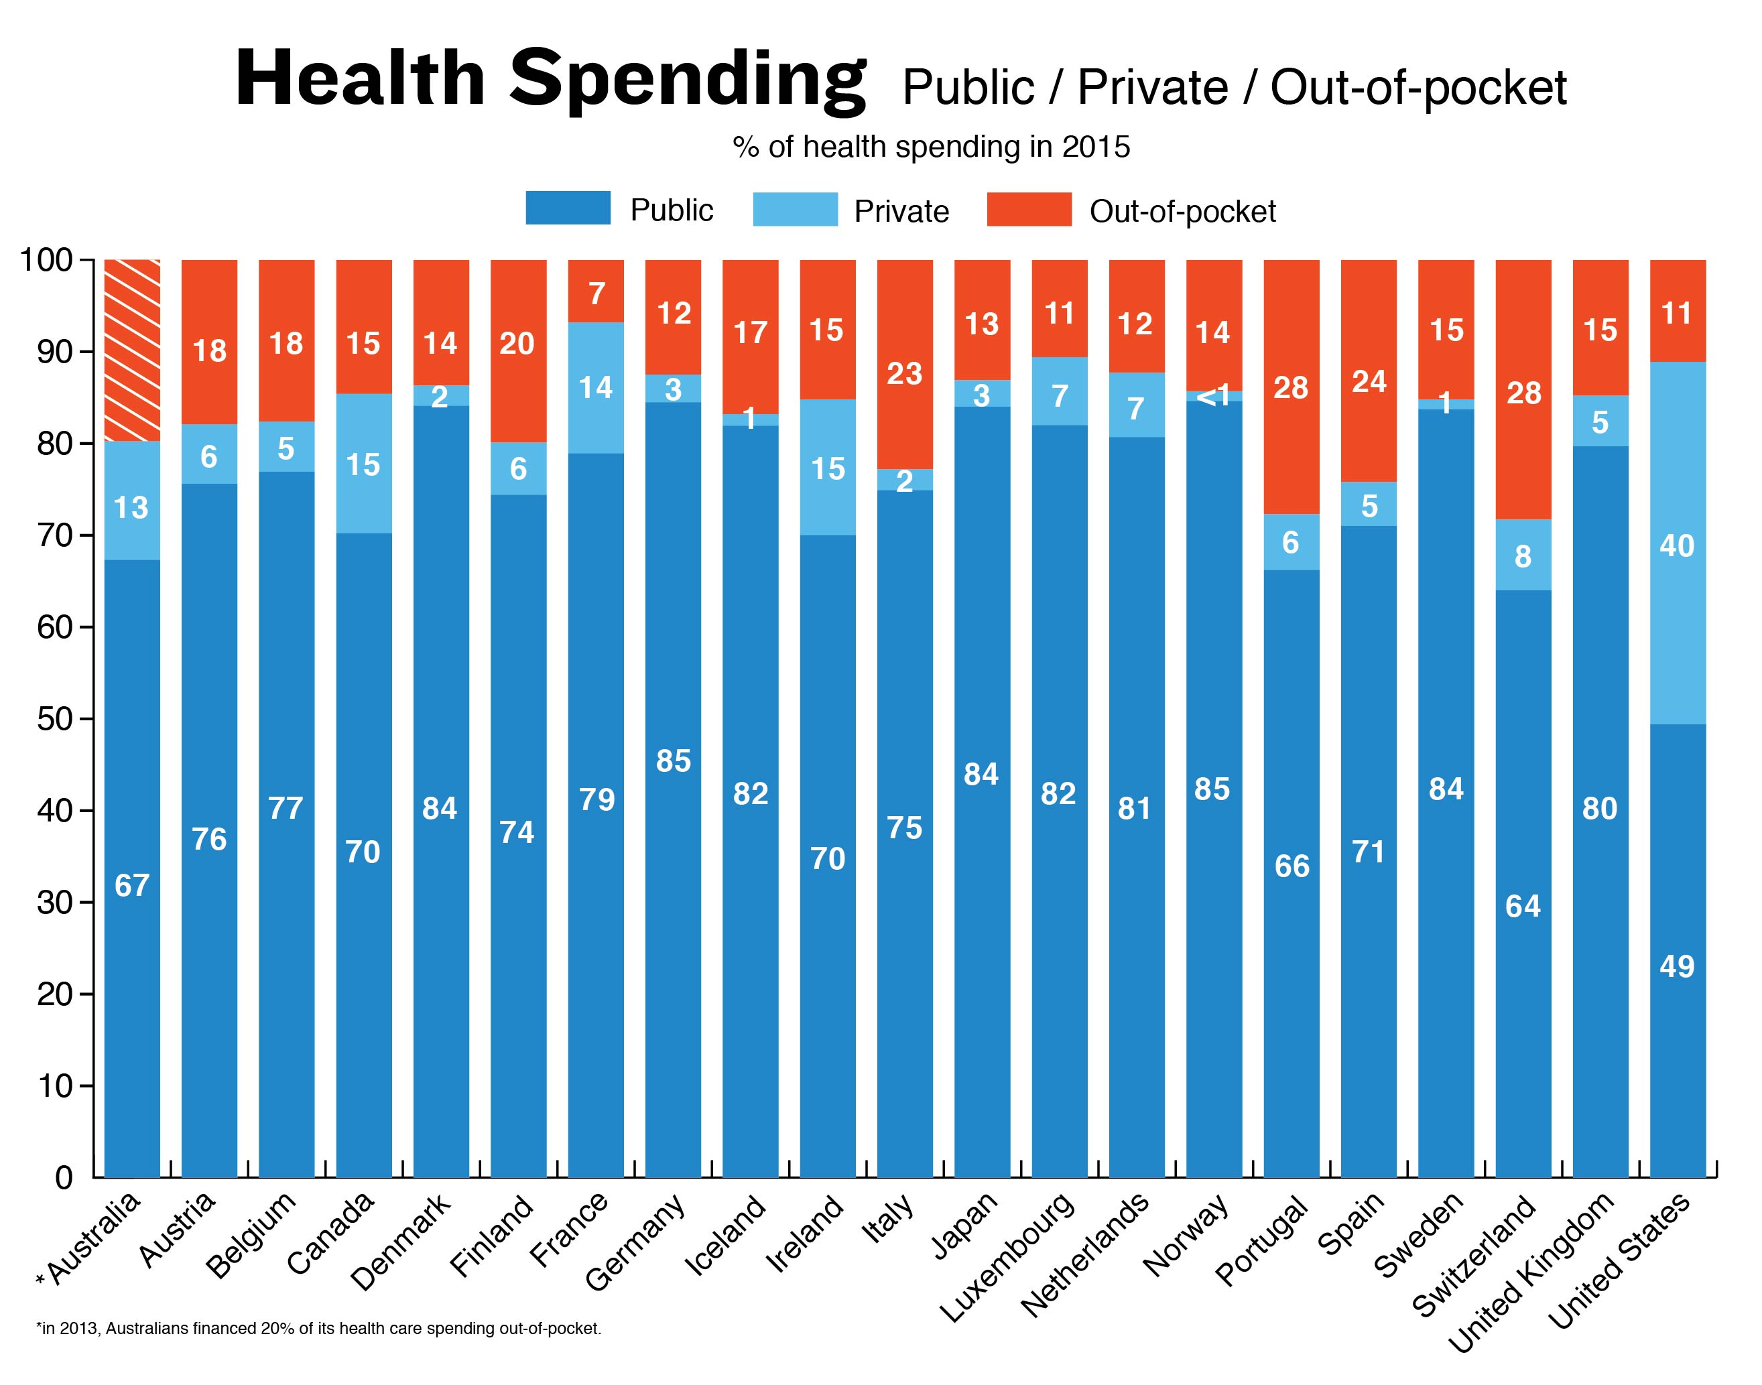

Slide 41
Health Care System Performance Compared to Spending
Higher
health system performance
Eleven-country average
Lower
health system performance
Lower health care spending
Higher health care spending
Note: Health care spending as a percent of GDP.
Source: Spending data are from OECD for the year 2014, and exclude spending on capital formation of health care providers.

Slide 42
Mortality Amenable to Health Care, 2004 and 2014
Deaths per 100,000 population
2004
2014
Source: European Observatory on Health Systems and Policies (2017). Trends in amenable mortality for selected countries, 2004 and 2014. Data for 2014 in all countries except Canada (2011), France (2013), the Netherlands (2013), New Zealand (2012), Switzerland (2013), and the U.K. (2013). Amenable mortality causes based on Nolte and McKee (2004). Mortality and population data derived from WHO mortality files (Sept. 2016); population data for Canada and the U.S. derived from the Human Mortality Database. Age-specific rates standardized to the European Standard Population (2013).

Slide 43
Growth of ACOs

Slide 45
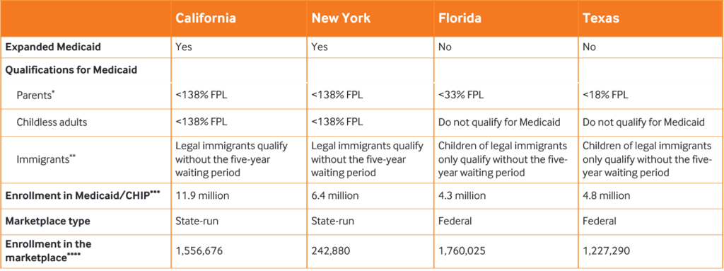
ACA Effects

Slide 49
Delivery of care only in the office (after an average 38 minute wait) or by alternative sites and telemedicine?
Are you measuring and demonstrating outcomes? True outcomes? The disruptor will prove to the public that they are better and faster for access!
Is that you?
Can you demonstrate that your care is more cost effective while providing same or better outcomes? Do you even know what it costs you to provide an episode of care? In ambulatory plus inpatient? Uber would be on your watch with advice when you wanted it, not 8:30 to 4:30 M-F
Accuracy of diagnosis? Reliability of treatment?
Are you a team of providers? Is your incentive program a group one or an individual one?

Slide 51
The Problem
Like most AMCs:
  Deeply tertiary and quaternary faculty
    1750 faculty = ~1100 Clinical FTEs
    79 faculty PCPs = ~45 Clinical FTEs
  ~2000 patients per PCP FTE = 90,000 population
    Insufficient to maintain tertiary and quaternary programs
      e.g. NCI Cancer Center or Transplant programs
    Insufficient population to maintain subspecialty Fellowships
    Insufficient to population support clinical and translational research
  Facing exclusion from side-by-side and narrow networks
  MACRA/MIPS payment threat
  Payment Reform towards fee-for-value
  Perception of being the ‘highest cost’ providers
    Lack of useful comparator data
    Unit costs v. total costs of care

Slide 52
Employers Transitioning
Payer Attribution ACO: Member attributed to SWHR PCP from prior year’s visits
PCP Tiered Model: Member attributed to SWHR PCP as a result of PCP benefit differential (copay reduction)
Facility Tiered Model: Narrow network with benefit differential at the point of care
Side-by-Side Product Model: Narrow network with premium contribution decrement at the point of enrollment
Full Replacement Product Model: Full replacement narrow network with premium contribution decrement, benefit differential and gatekeeper model
D I SRUPT ION
Full Replacement Product Model
Side-by-Side
Product Model
Facility Tiered Model
PCP Tiered Mode
Payer Attribution ACO Model
Total Cost of Care Savings
Payer Attribution
PCP Tiered Model
Facility Tiered Model
Side-by-Side Product
Full Replacement Product
Notes:
Healthcare Evolution

Slide 53
Population Health Services Company
Scope of Services:
  Data Analytics/Actuarial Analysis and Workflow Platform
    Risk stratification
    Predictive modeling
  Practice-Centric Services
    Scheduling/Access/Referral Management/Care Navigation
    EMR and IT Services for Physician Groups
  Care Coordination Services
    Care Gap Identification/Closure
    Care Transitions Management
    Chronic Disease Management/Care Models
  Care Administration Services
    Utilization Management/Review
    Bundles Administration
  Quality Improvement
    Dashboard and specific goals
  Total Cost-of-Care Performance Dashboard
  Patient Experience and Engagement
  Post-Acute Care Network with Scorecard

